Slide 1
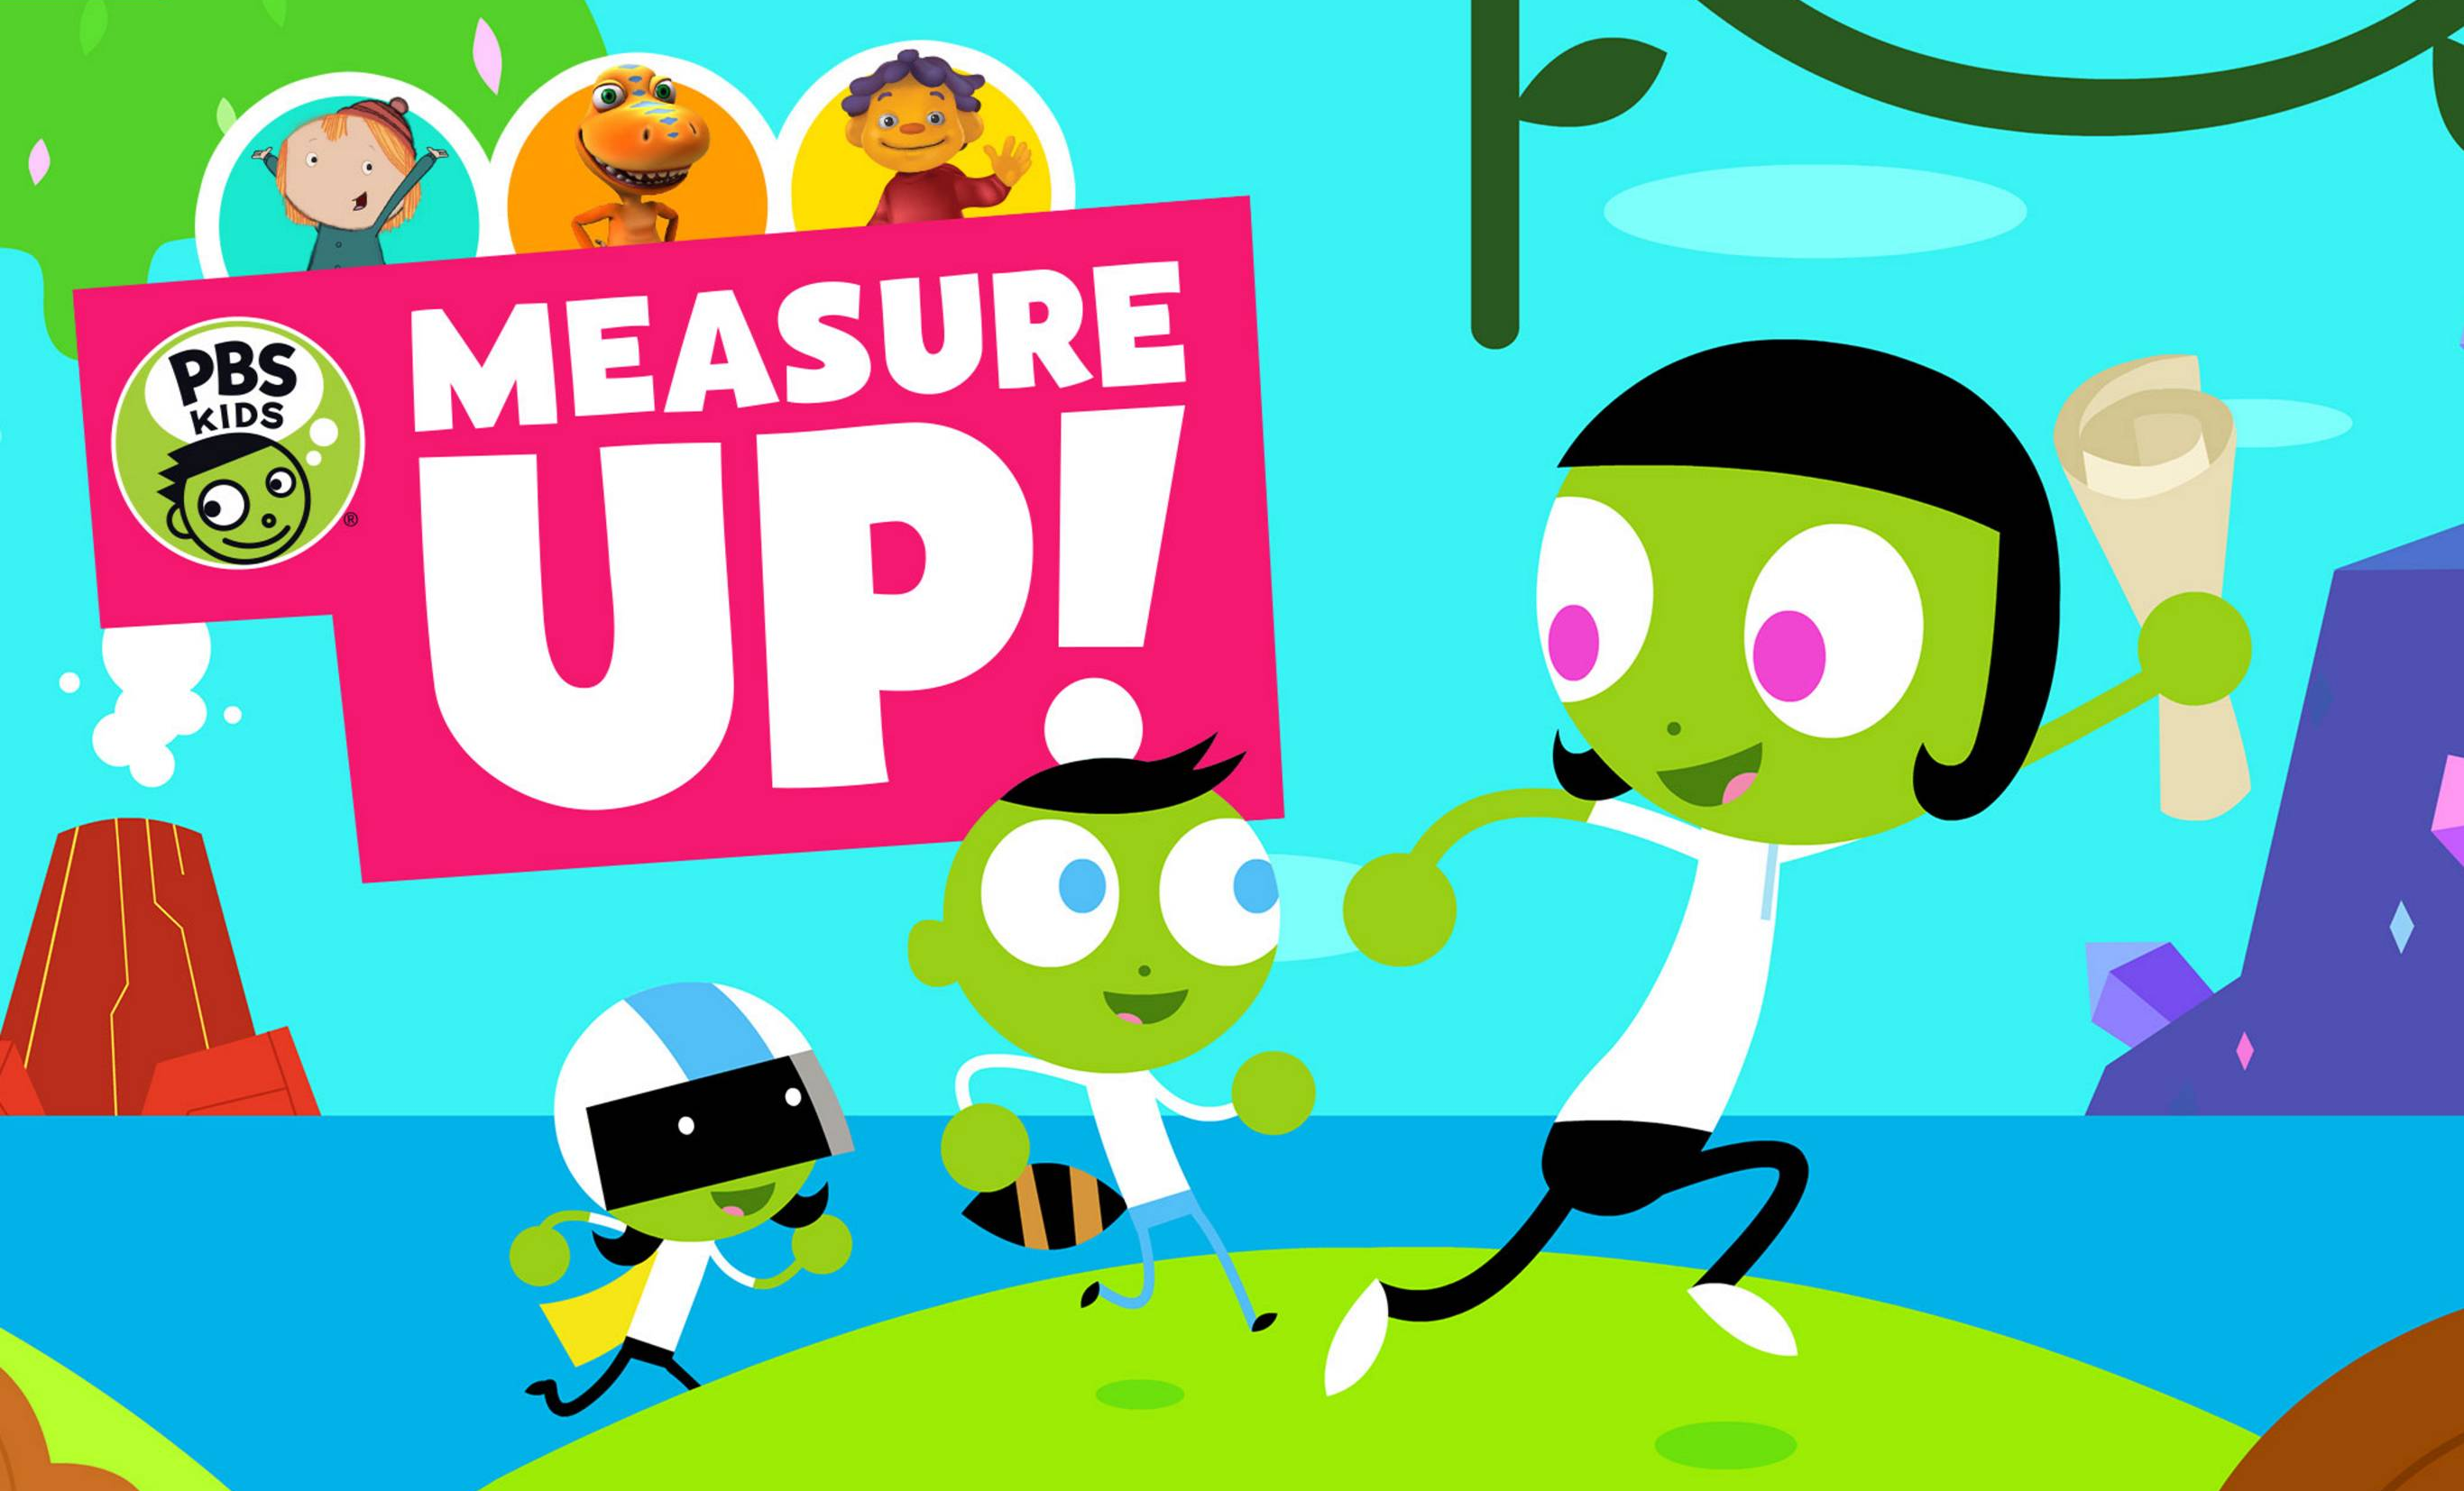
Predicting Children’s Learning Outcomes
HUY BUI

Slide 2
Table of Content
Page 5
Page 21
Page 14
What is PBS
Kids Measure Up?
Feature Exploration
Model
Future
Implementation
Objective
Preprocess
Conclusion
Page 3
Page 16
Page 9
Page 22

Slide 3

I. What is PBS Measure Up Kids?

Slide 4

2019 Data Science Bowl
Biggest Kaggle competition in 2019
Prize pool: $160,000

Slide 5
More info
Installation: 17000
Game Session: 303319
Event Code: 42
Event Id: 384
Title: 44
Type: 4
World: 4
…
II. Objective
Where does the data come from?
Install the game
If title type is Assessment,
label the performance
World
Title
(unique game session)
Play
(Action triggers event)
4 possible outputs
Predict 1000 players

Slide 6
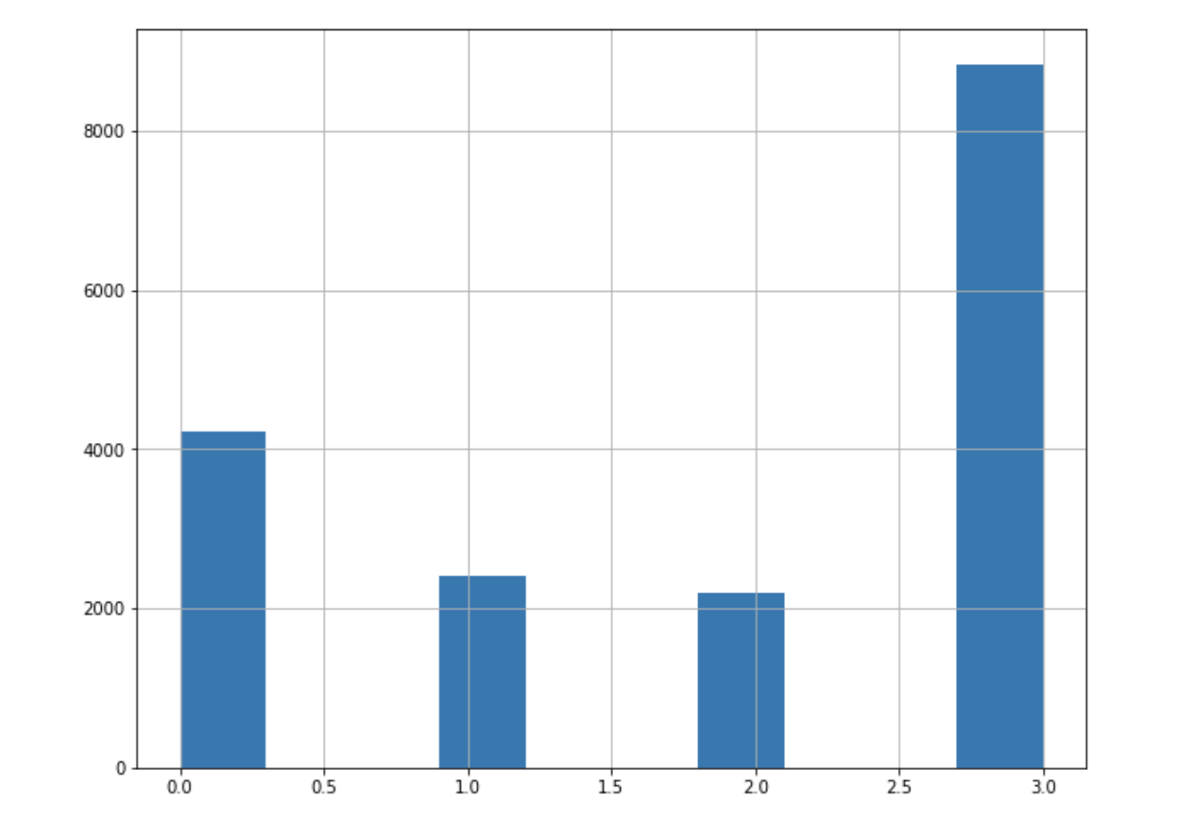
Output Distribution
The outcomes are grouped into 4 groups:
3: the assessment was solved on the first attempt
2: the assessment was solved on the second attempt
1: the assessment was solved after 3 or more attempts
0: the assessment was never solved

Slide 7
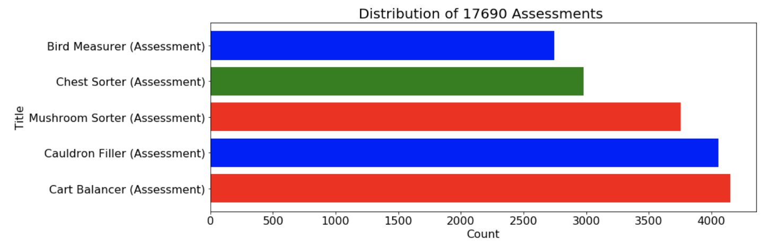
Assessment Distribution
Mushroom Sorter (Assessment) : TREETOP CITY
Bird Measurer (Assessment) : TREETOP CITY
Cauldron Filler (Assessment) : MAGMA PEAK
Chest Sorter (Assessment) : CRYSTAL CAVES
Cart Balancer (Assessment) : CRYSTAL CAVES

Slide 8
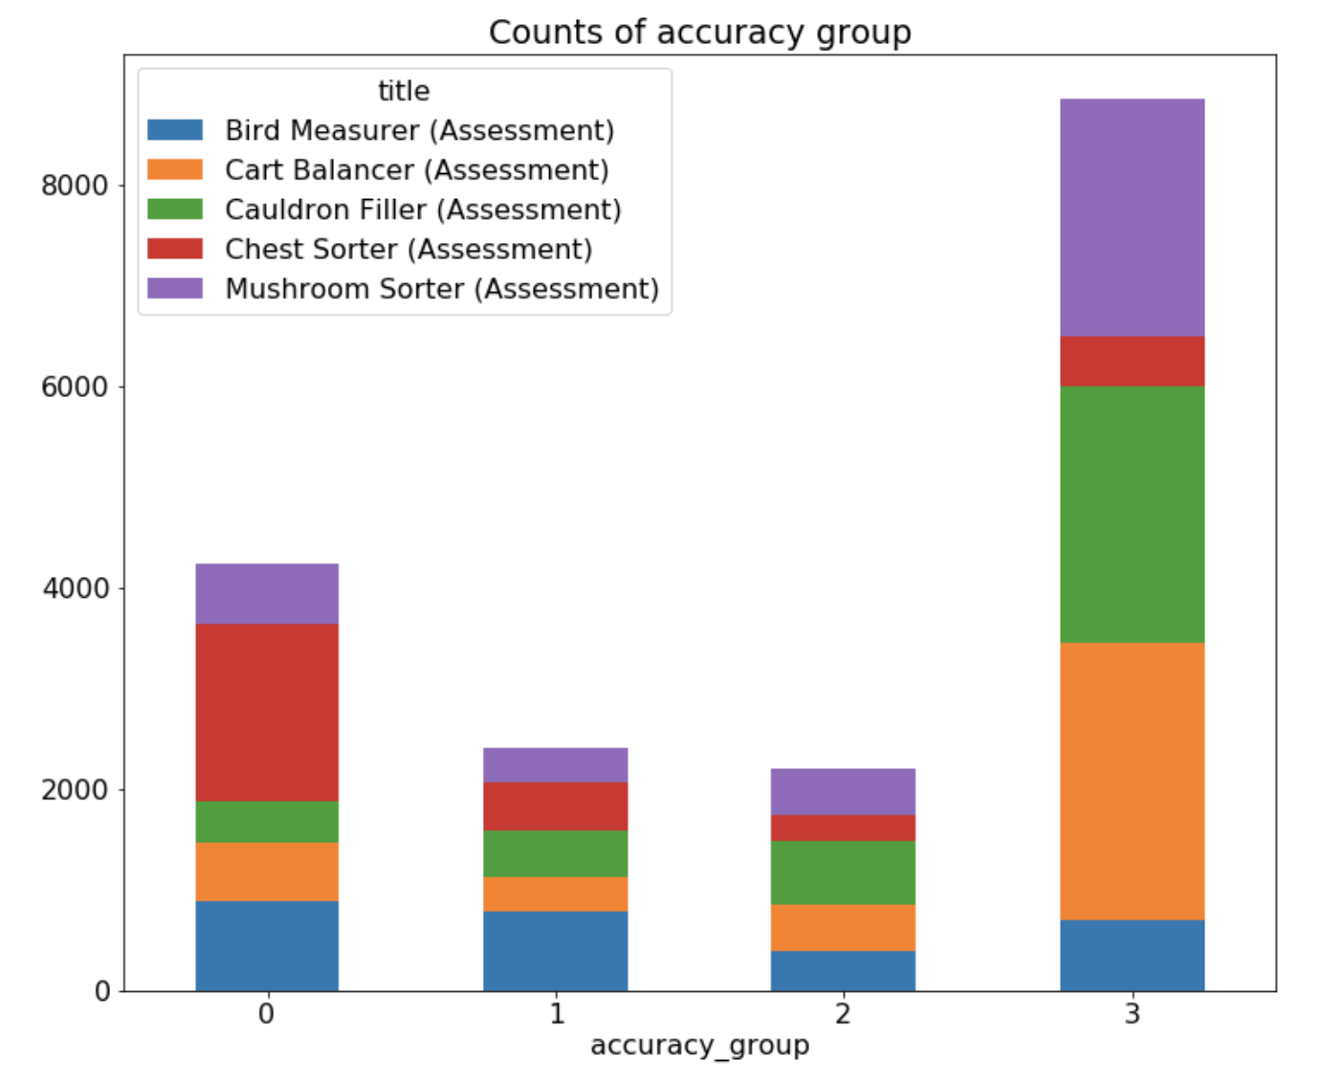
Labels and Assessment Distribution

Slide 9

III. Feature Exploration
World
Treetop City (Length/Height):
17 titles
2 assessments
Magma Peak (Capacity & Displacement):
11 titles
1 assessment
Crystal Caves (Weight) :
15 titles
2 assessments

Slide 10
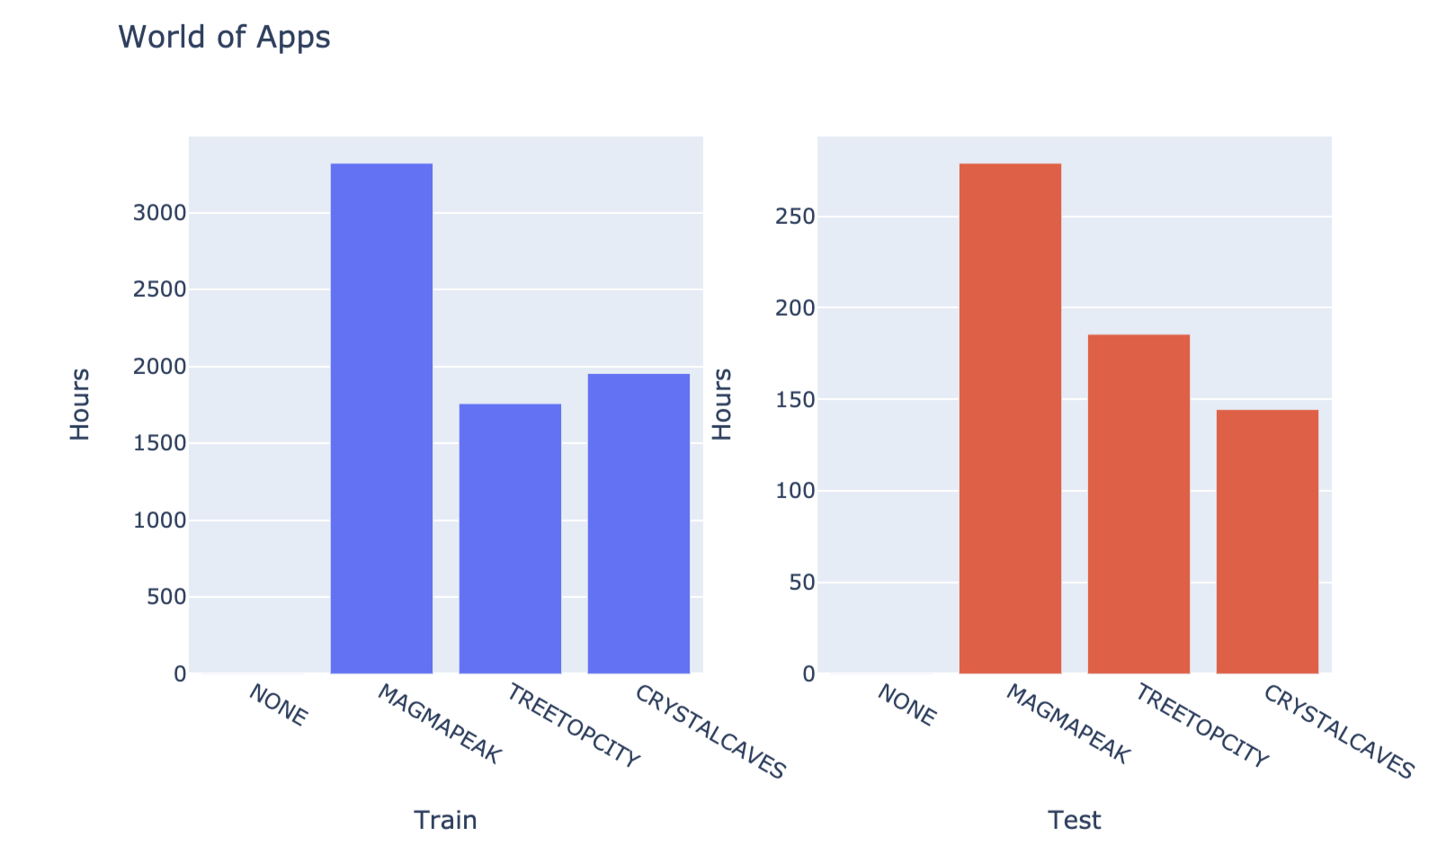
Time Spent on Each World

Slide 11
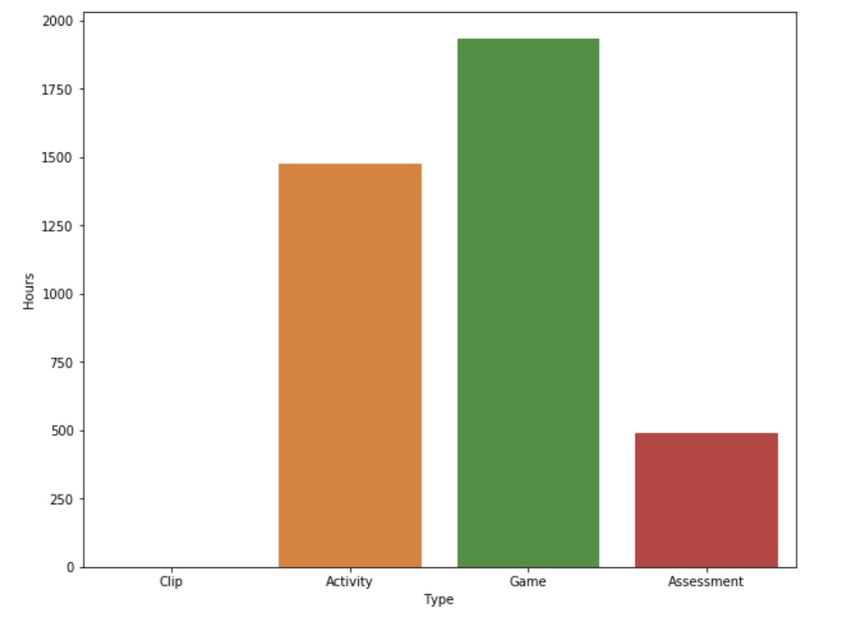
Time Spent on Each Type
Phase of the Learning Cycle
Exposure -> Playground -> Practice -> Test

Slide 12
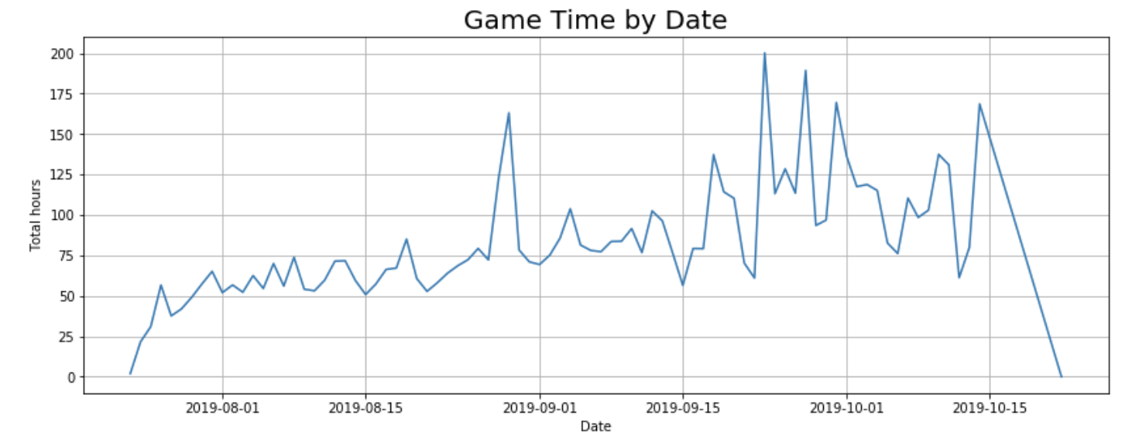
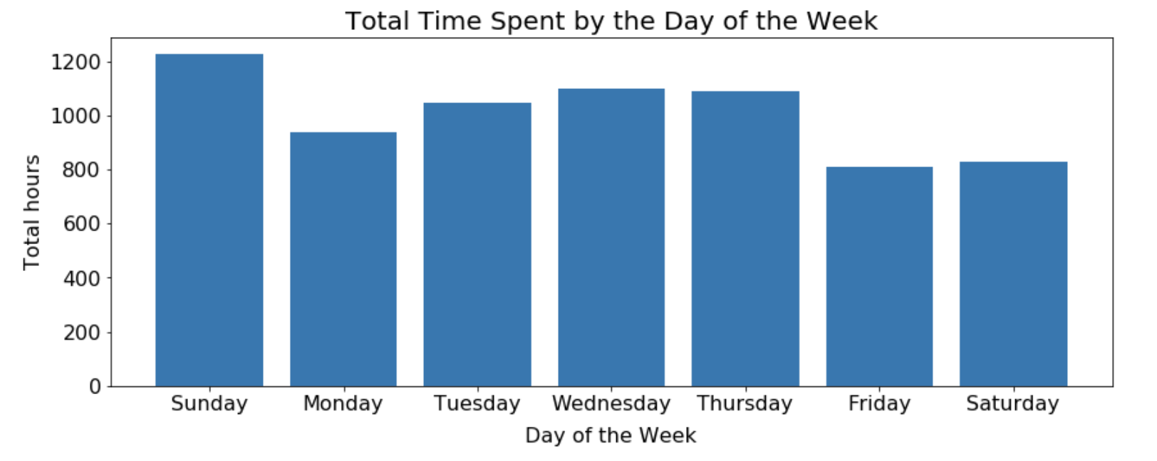
Time Series

Slide 13
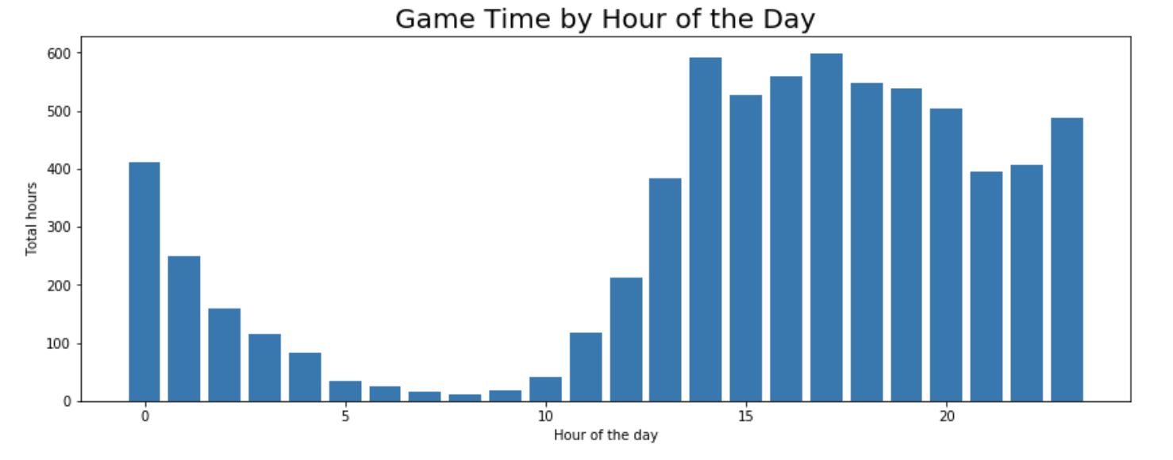
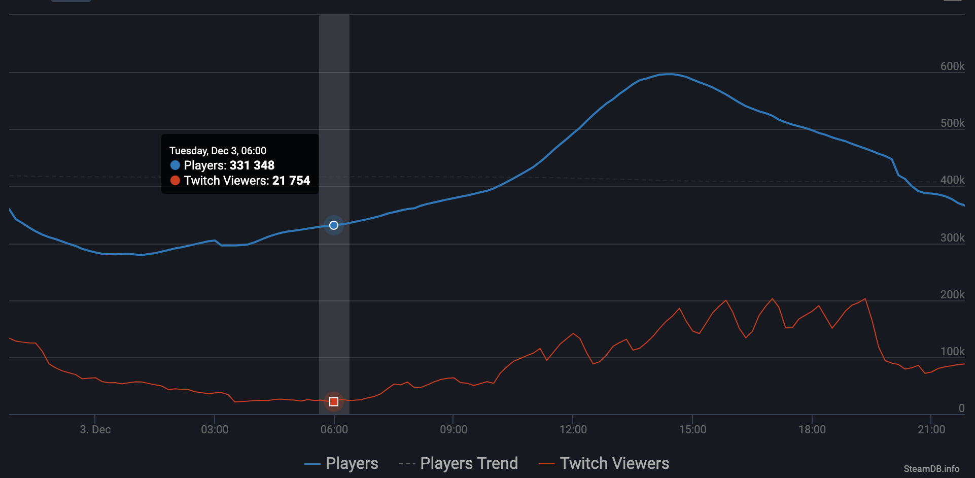
Similarity Between PBS Kids and Dota 2
Midnight

Slide 14
IV. Preprocess
Train before: (11341042,11)
Test before :(1156414, 11)
Train after : (18837, 533)
Test after: (1000, 533)

Slide 15
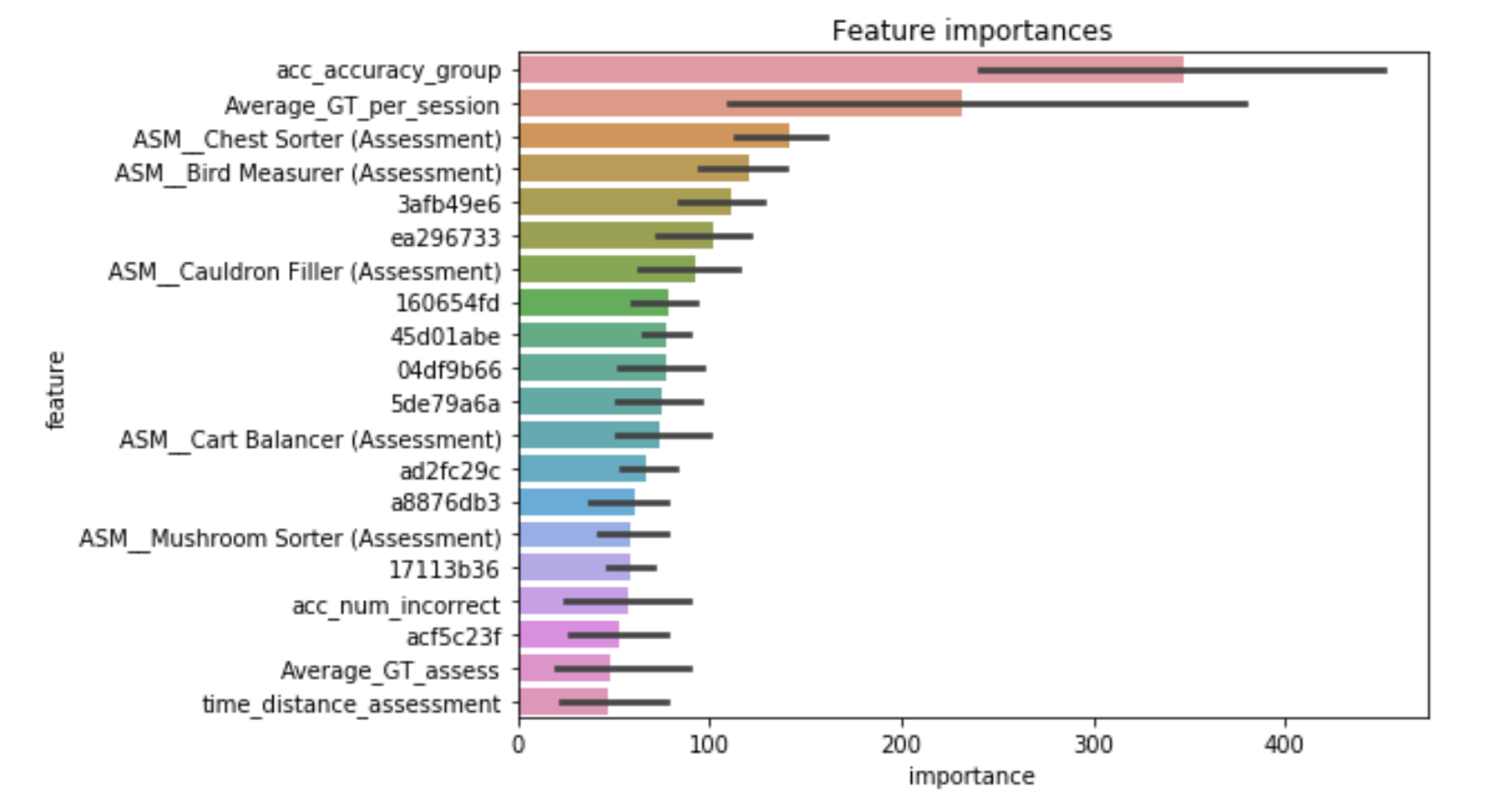
Feature Importance

Slide 16
V. Modeling
Attempt 1: Simple Classification
Gradient Boosting (GB), eXtreme Gradient Boosting (XGBoost),
Light Gradient Boosting Machine (LGBM) , Random Forest Classifier (RFC)

Slide 17
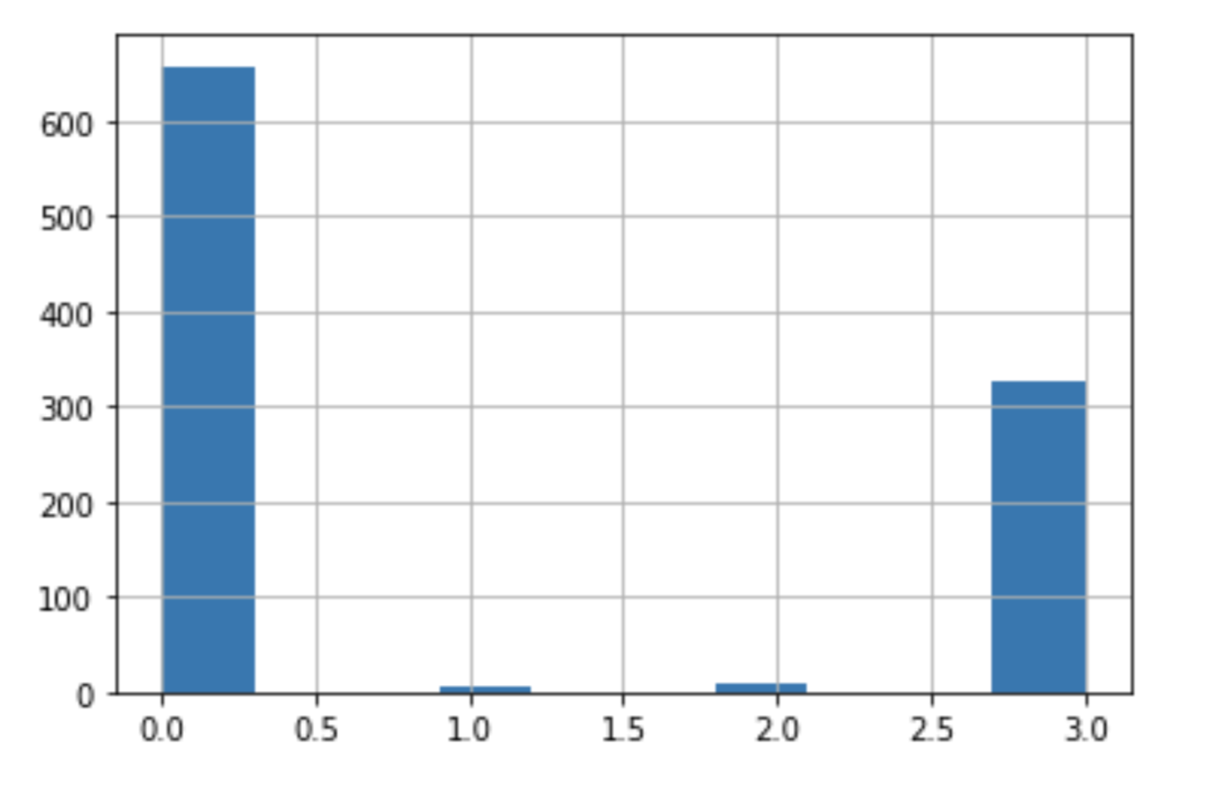
Group Distribution of the First Attempt
Group 0: 658
Group 3: 327
Group 2: 9
Group 1: 6

Slide 18
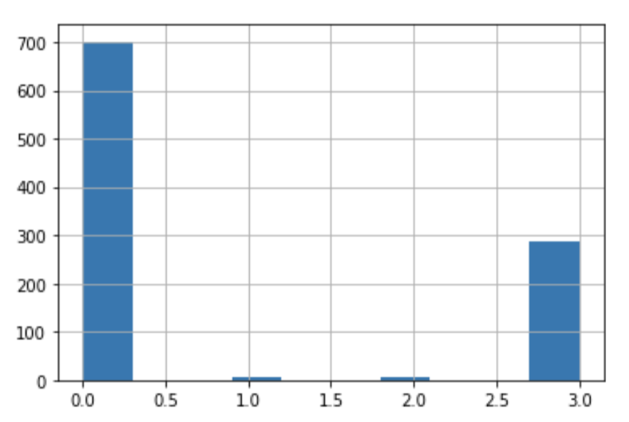
Second Attempt: One-vs.-Rest
Data
Binary classification between group 0 and non-zero
Multinomial classification between 1,2, and 3
Group 0
Group non-zero
Group 1
Group 2
Group 3
Group 0: 701
Group 3: 281
Group 2: 7
Group 1: 5

Slide 19
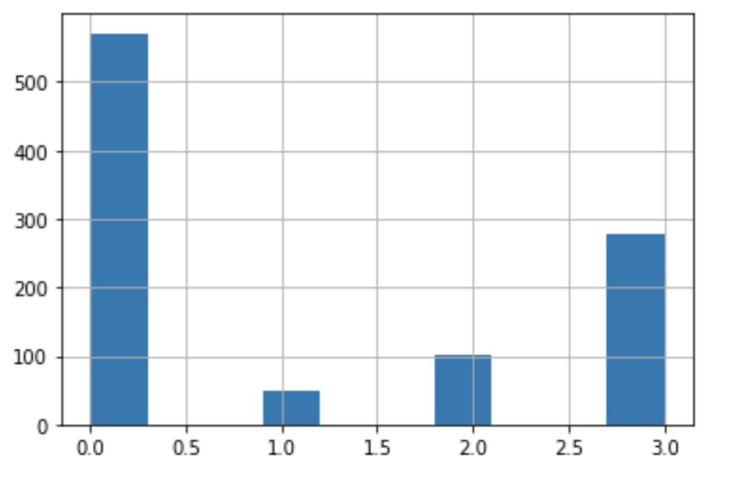
Third Attempt: Regression on a Classification Problem
x < 0.879
Group 0
0.879 < x < 1.66
Group 1
Data
Tuned LGBM regressor
Positive real number x
Optimized rounder
1.66 < x < 2.366
Group 2
x > 2.366
Group 3

Slide 20
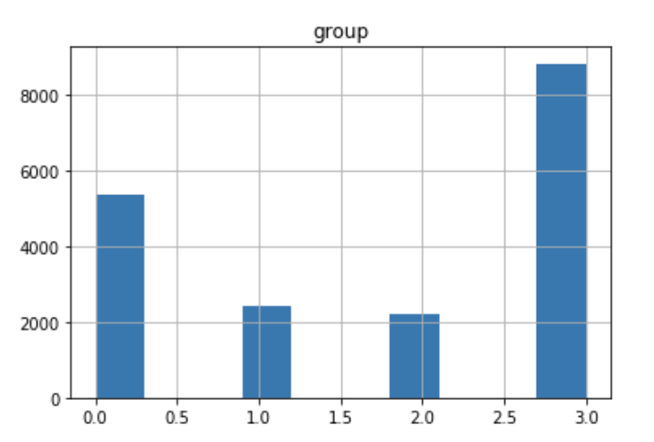
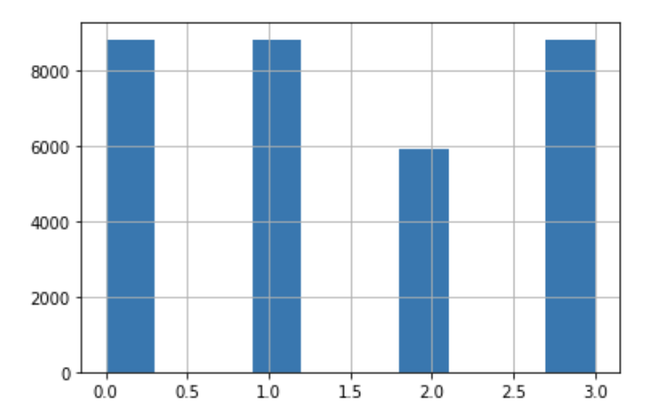
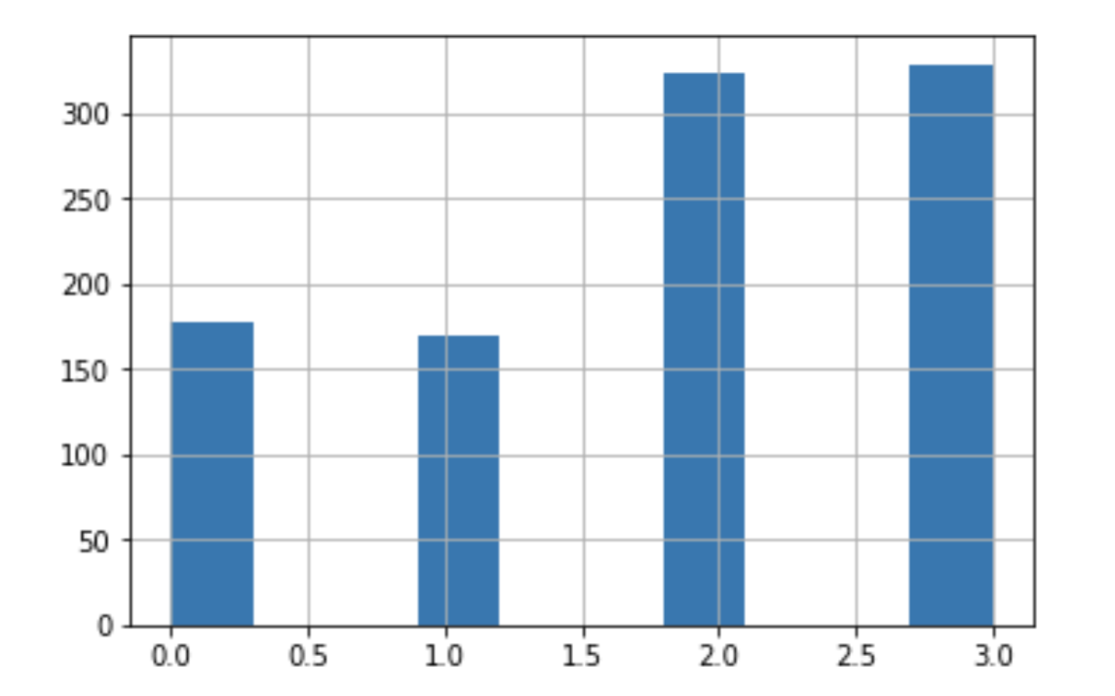
Fourth Attempt:
More Feature Engineering (892)
Train
SVMSMOTE
17k observations
533 features
LGBM Regressor
32k observations
892 features
LGBM Regressor
Test

Slide 21
VI. Conclusion
Baseline : 0.395
4th attempt: 0.526 (top 30%)
LGBM is better than XGB, Random Forest, and GB
The train set is highly overfitting due to how test set is truncated.
Preprocessing and feature engineering are 95 percent of the job

Slide 22
VII. Future Implementation
Make the train set and test set look more similar
Try Bayesian optimization
Under-sampling group 0
Blending different results from the other kernel
Just stop and work on something else

Slide 23
Questions ?

Slide 24
Weighted Cohen Kappa Metric
The kappa statistic is frequently used to test inter-rater reliability.
Similar to mean square error, the closer to the actual value the better.
The score is ranging from -1 to 1, Landis & Koch (1977) explain the Kappa value as follow:
<0 No agreement
0 — .20 Slight
.21 — .40 Fair
.41 — .60 Moderate
.61 — .80 Substantial
.81–1.0 Perfect

Slide 25
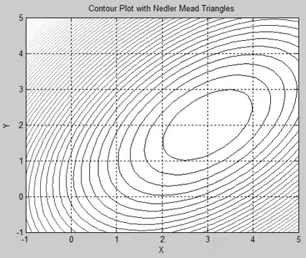
Optimizer Rounder

Slide 26
Synthetic Minority Over-Sampling Technique
SVM decision line
Extrapolation
Interpolation
SMOTE
SVMSMOTE
1, 2

Slide 27
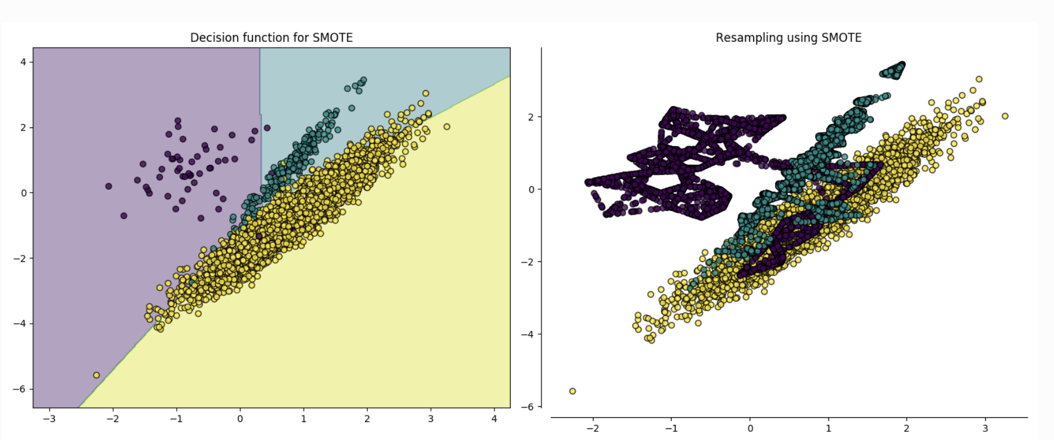
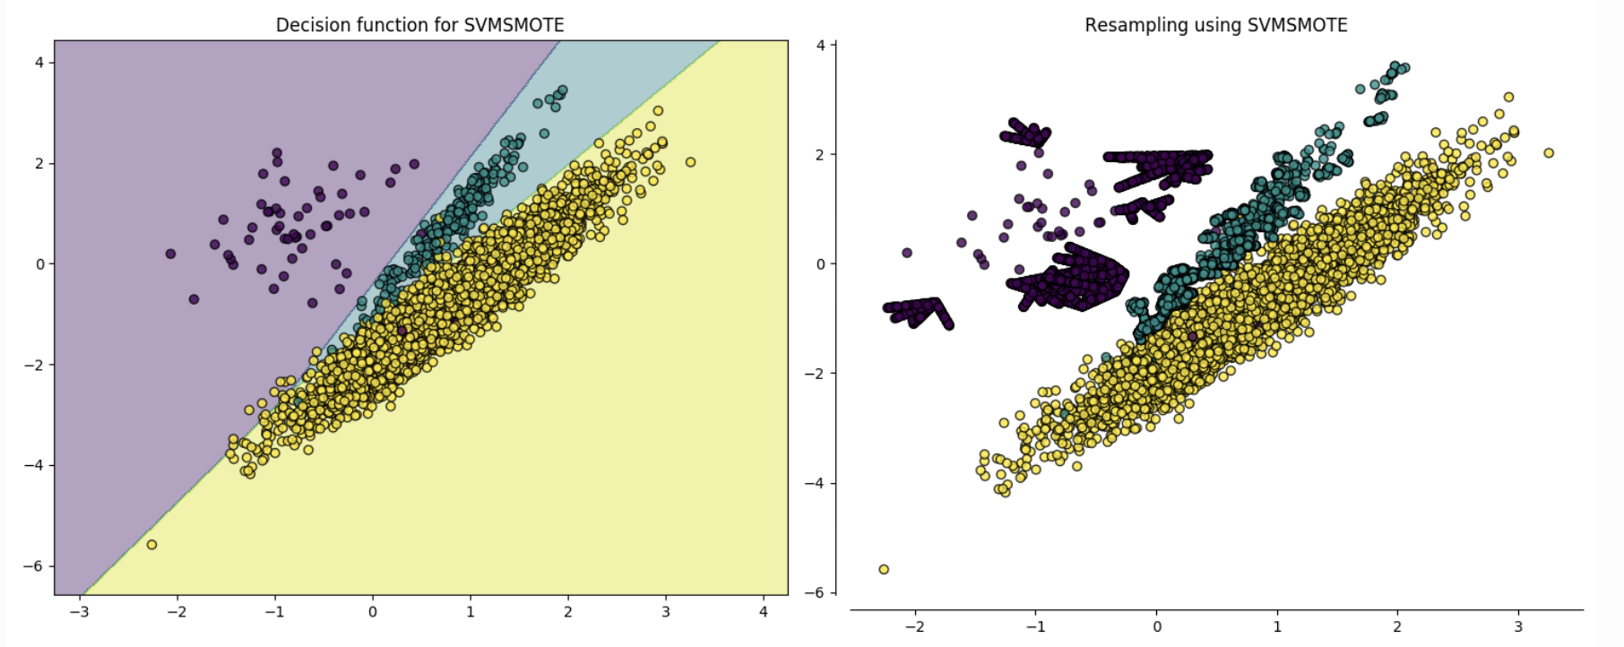
Synthetic Minority Over-Sampling Technique

